Slide 1
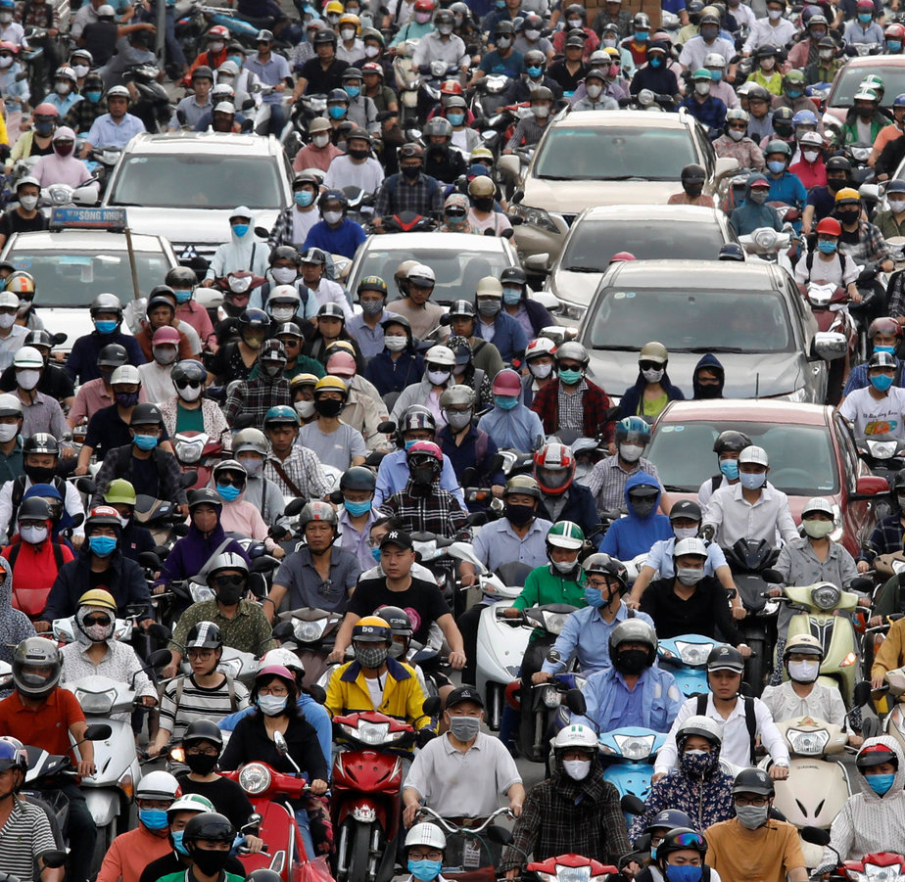
Definitions
Non-rival: one person enjoying the good does not keep others from enjoying it
Non-excludable: once a resource is provided, even those who fail to pay for it cannot be excluded from enjoying its benefits

Slide 2
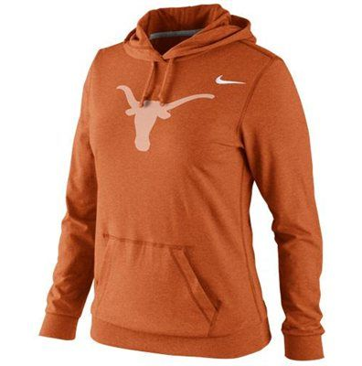
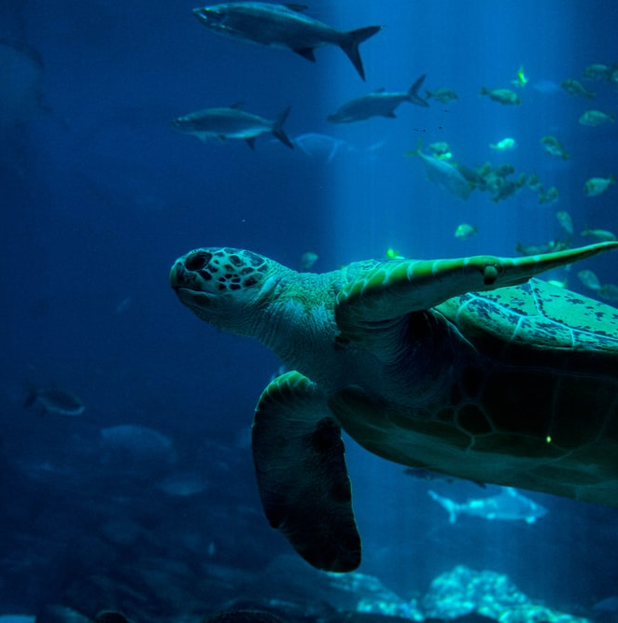
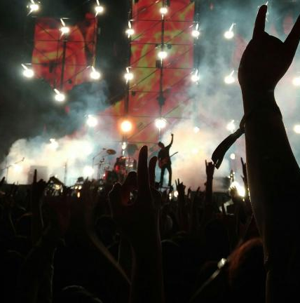
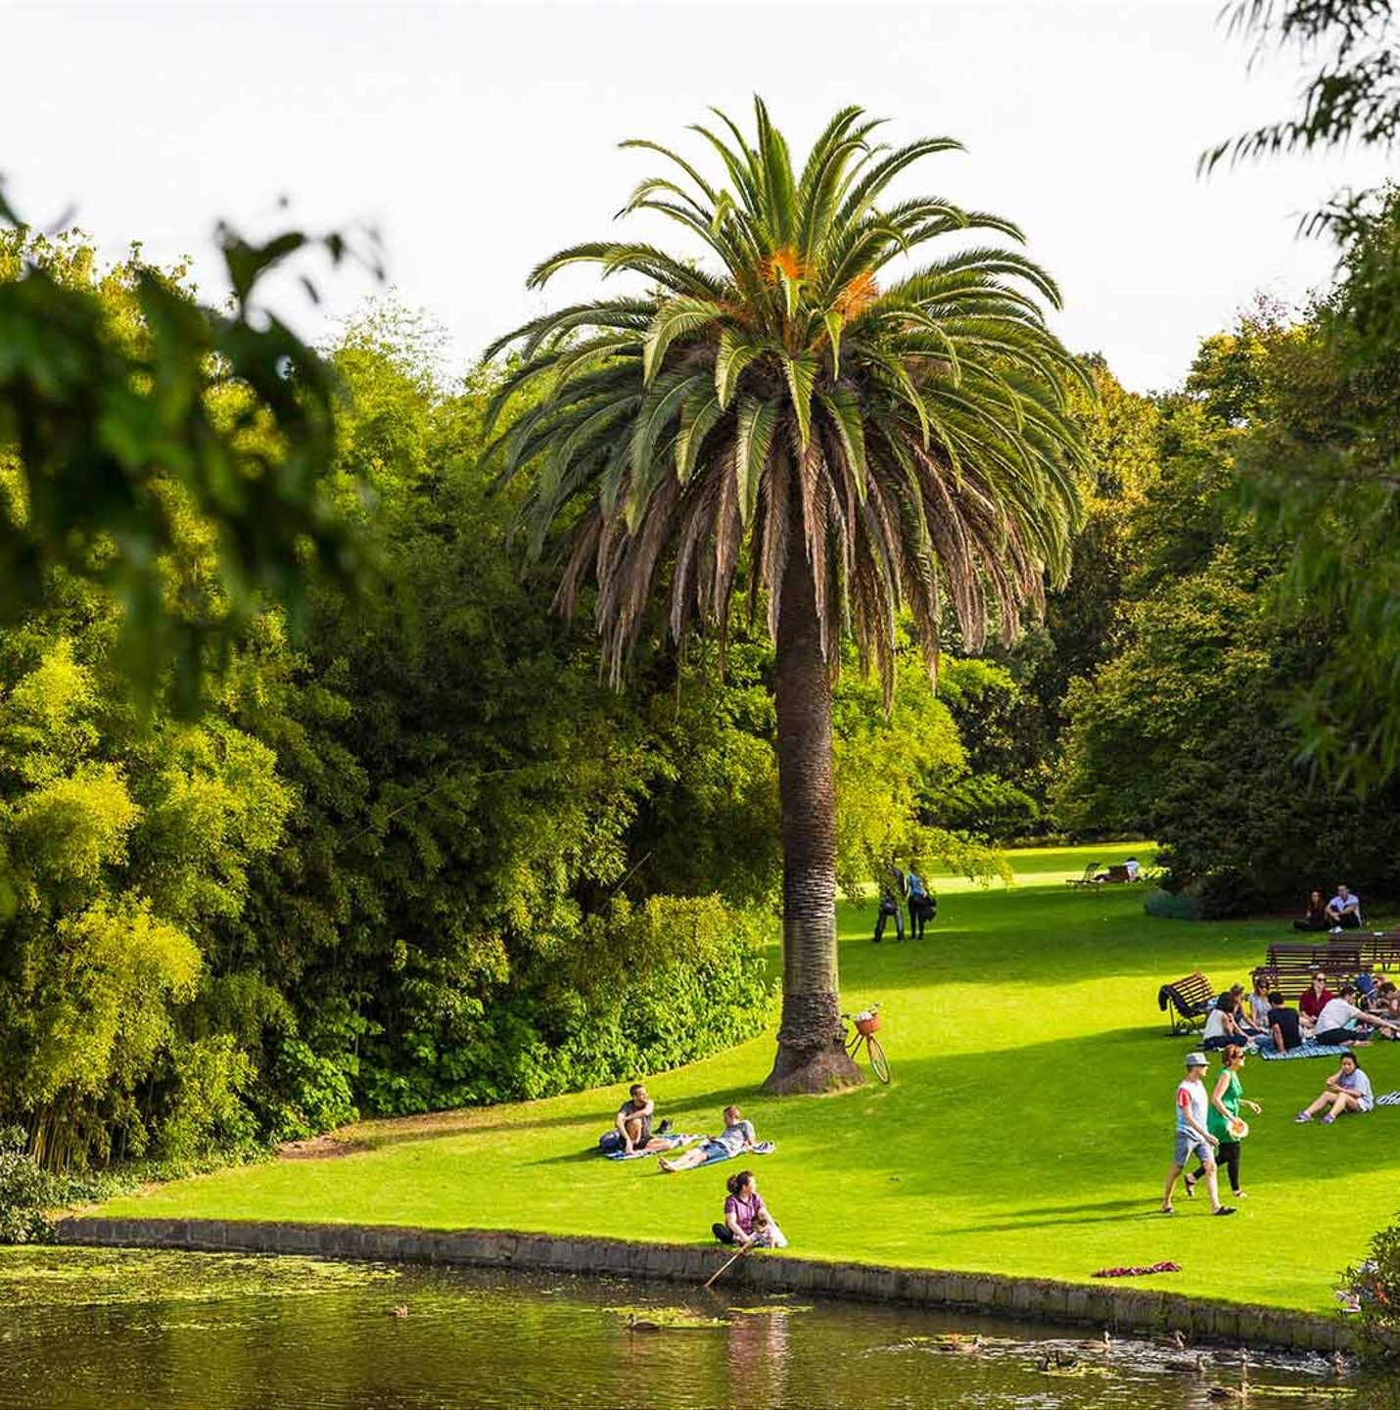
Four Types of Goods
Private Good
Common Resource
Excludable
Rival
Not Excludable
Rival
Club Good
Public Good
Excludable
Not Rival
Not Excludable
Not Rival

Slide 3
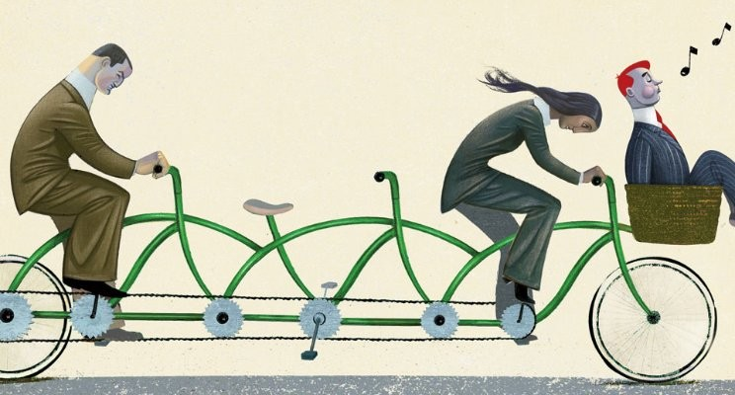
Free riding
Free-rider: someone who derives value from the public good without paying an efficient amount for its supply.
I benefit from the amount that you are willing to pay to provide
No incentive to contribute – end up with under provision of the public good, below the efficient level

Slide 4
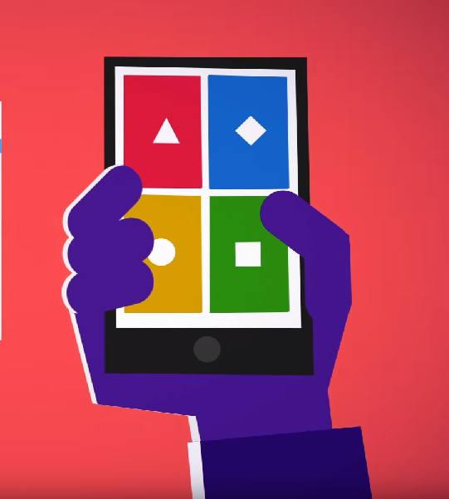
Launch the Kahoot! app or go to Kahoot.it to play the challenge.
!
For your Kahoot! nickname, use your EID. You must do this to earn participation points.
!
!
Points are earned for correct answers, not speed.

Slide 5
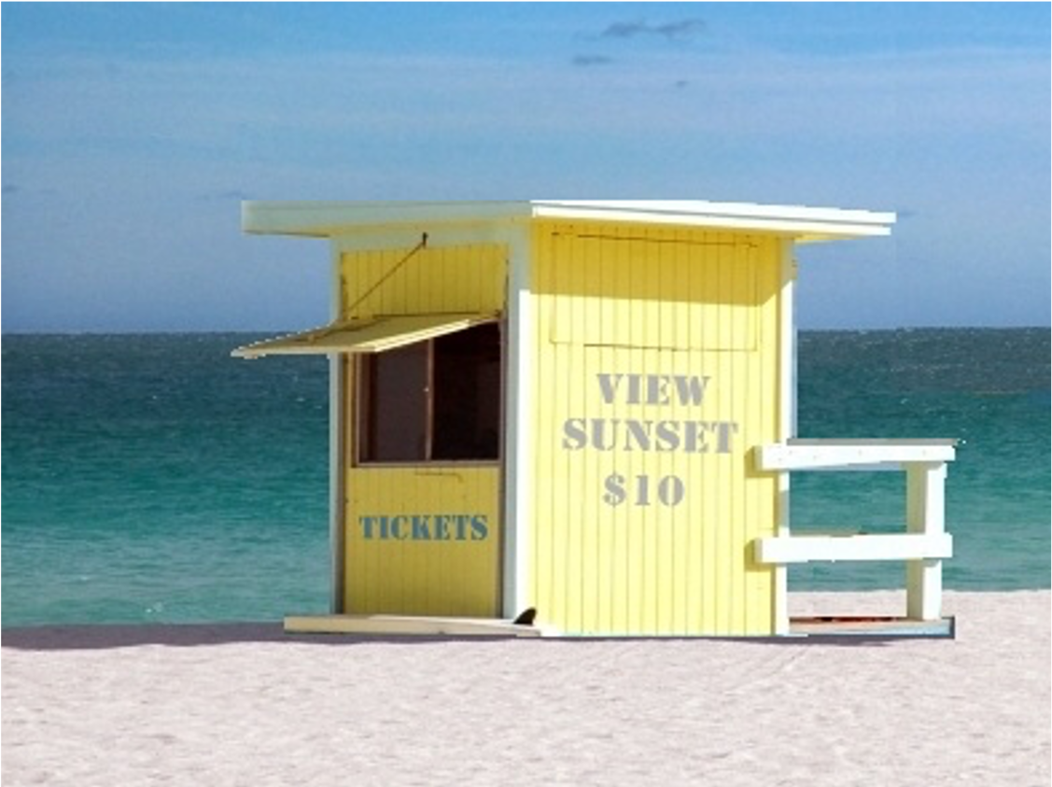
What is wrong with this picture?

Slide 6
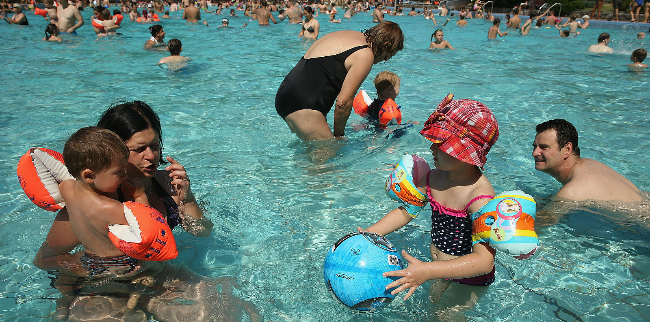
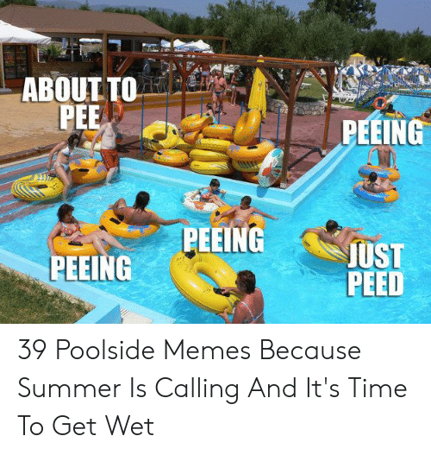
The tragedy of the commons is the tendency for a resource that has no price to be used until its marginal benefit = 0.
The most important invention you’ve never heard about!
Do you pee in the pool?

Slide 7
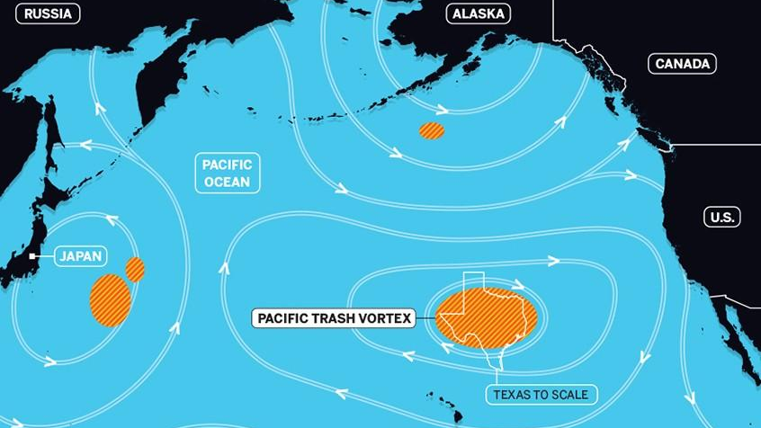
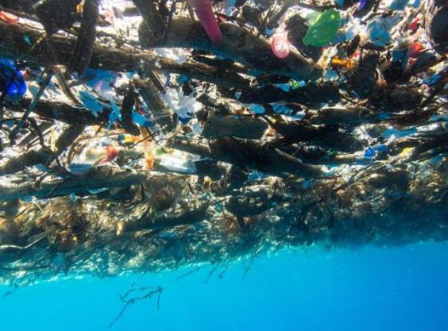
The Great Pacific Garbage Patch

Slide 8
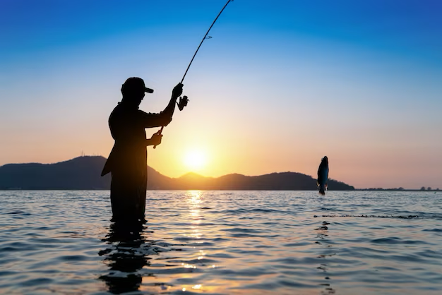
Let’s Fish Demonstration
Each of you fish – you get to eat what you catch
The pink represent fish that can spawn – I will x2 the pink fish that are left
Next season, we fish again.

Slide 9

Elinor Ostrom
2009 Nobel Laureate in Economics
for her analysis of economic governance, especially the commons.

Slide 10
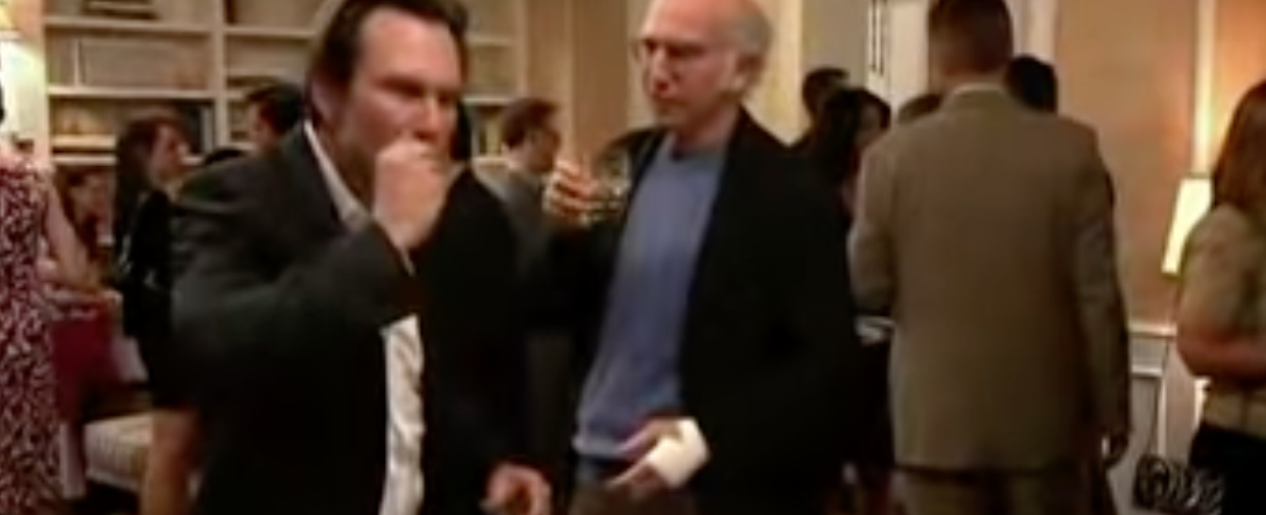
Social Norms do matter
“Unwritten laws in society”

Slide 11
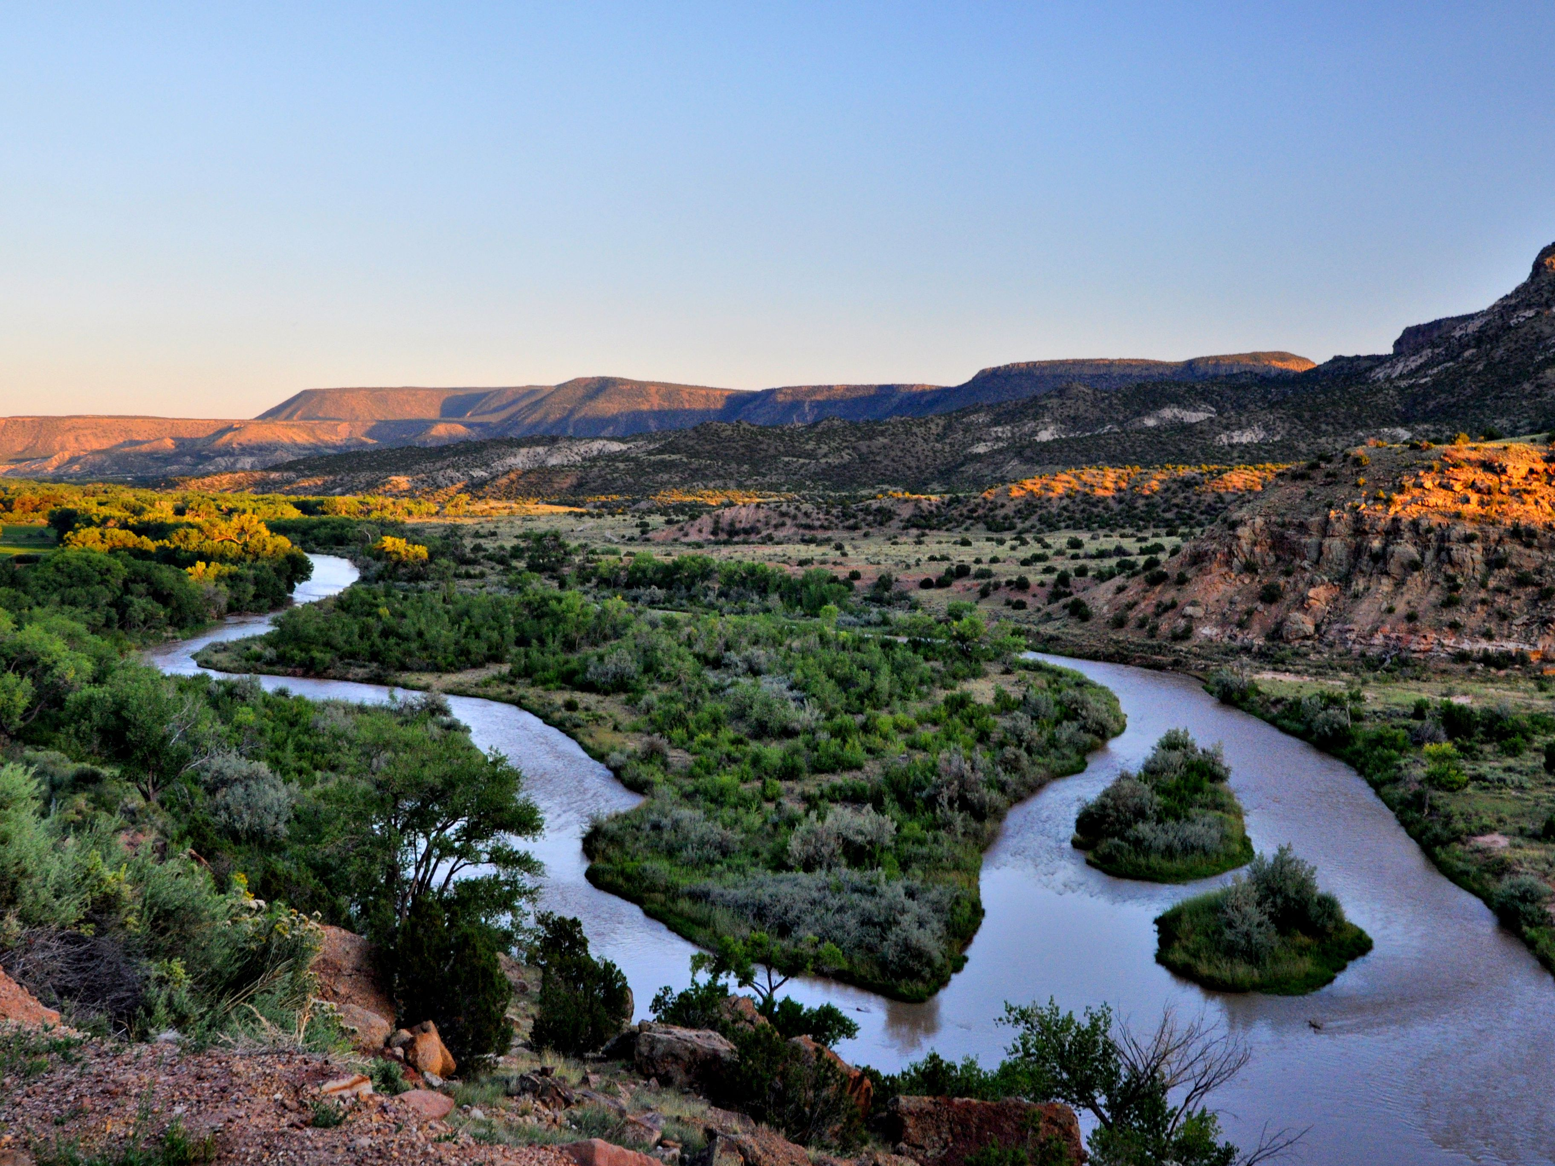
Tiered-Pricing for Water Usage, Santa Fe, NM

Slide 12
Launch the Kahoot! app or go to Kahoot.it to play the challenge.
!
For your Kahoot! nickname, use your EID. You must do this to earn participation points.
!
!
Points are earned for correct answers, not speed.

